Slide 1
Performance of multiple individual haplotype assembly algorithms
Shuying Sun & Sherwin Massoudian
Department of Mathematics, Texas State University, San Marcos, TX

Slide 2
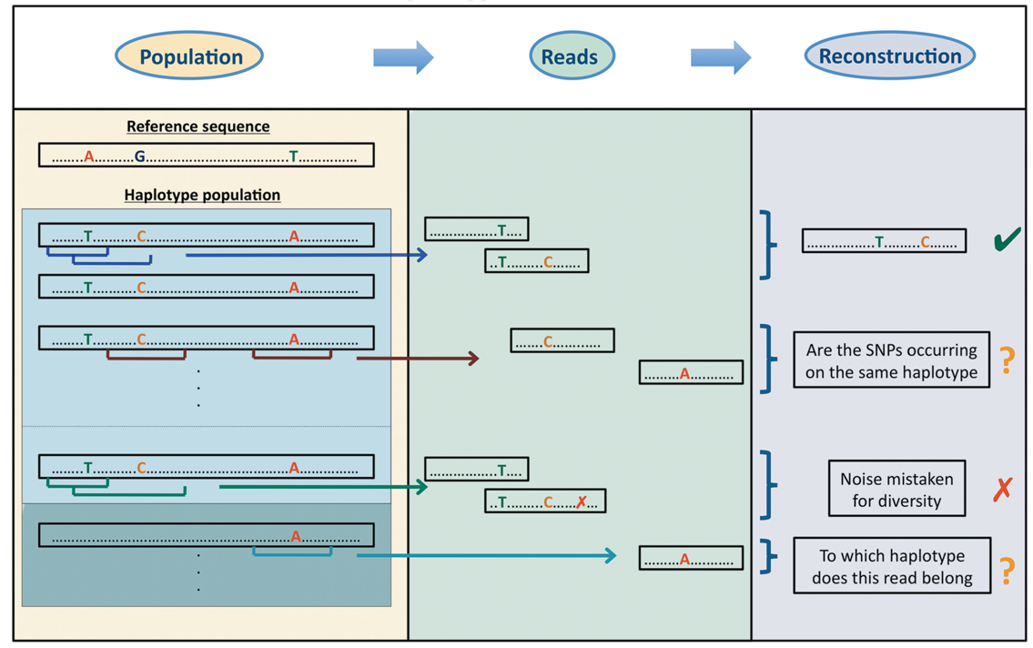
Haplotype assembly
SNP (SNV): Single Nucleotide Polymorphism (Variant)
Haplotype: a set of DNA variants (e.g., SNP) inherited together from one parent (or one chromosome)
Haplotype Assembly: Infer haplotypes using DNA sequencing reads
Haplotype Reconstruction
Ref: Figure 1 of Schirmer 2014: https://www.ncbi.nlm.nih.gov/pubmed/23257116

Slide 3
Challenge and Importance
It is challenging to conduct haplotype assembly because DNA sequencing datasets are often very large and have complex genetic and technological features.
Haplotype assembly can be used for inheritance analysis, evolutionary selection, study of gene function, medication intervention, ect.
There are about 60 Haplotype Assembly Software Packages spanning from 2008 to 2020.
Our main goal is to compare three algorithms that can infer haplotypes for multiple individuals together.

Slide 4
Software Packages and Data Sets
MIHA: Multiple Individual Haplotype Assembly
DBM, 2013: A Bayesian Markov model for Phasing and Population Structure Analysis on sequencing Data.
HapSeq2, 2013: A HMM based method for both genotype calling and haplotype phasing.
Whatshap, 2015: A read-based phasing or haplotype assembly software that is especially suitable for long reads.
Datasets
5 samples: 826, 827, 832, 847, 850
Illumina Genome Analyzer IIx [GA2x] paired-end sequencing.
5 samples are unrelated colon cancer patients, designated cancer 1 to 5 in the paper from the link below: https://www.ncbi.nlm.nih.gov/pubmed/22878650

Slide 5
Workflow
Software: BWA
Input: FASTA reads
Output: SAM format
Software: Samtools 1.9
Input: SAM format
Output: BAM format
Software: Bcftools 1.9
Input: BAM format
Output: VCF file with SNPs
Software: WhatsHap
Input: VCF file with SNPs
Output: VCF file with haplotype
Software: grep, awk, sed
Input: VCF file with SNPs
Output: sample.snps
Software: grep, awk, sed
Input: SNP file and VCF file
Output: sample.counts
Software: DBM &HapSeq2
Input: SNP file and counts file
Output: sample.g

Slide 6
MIHA Running Time

Slide 7
Pairwise Comparison for 120 SNV data
120 total positions on >= 3 samples
Script: Pick3PhasingWhatshapHapseqDBM.2020.July.10.txt

Slide 8
Pairwise Comparison for 628 SNV data
628 total positions - phased >= 20 coverage
Script: PhasingWhatshapHapseqDBM.2020.July.1.txt

Slide 9
Conclusion & Discussion
It is vital to compare currently available algorithms.
The 3 MIHA algorithms do not have a high agreement rate.
HapSeq2 and Whatshap agree with each other well. But DBM does not agree with these two well.
One challenge of the comparison analysis is to find suitable real datasets with known haplotypes.
It is also challenging to compare a large number of algorithms.

Slide 10
References
Patterson, M., Marschall, T., Pisanti, N., Van Iersel, L., Stougie, L., Klau, G. W., & Schönhuth, A. (2015). WhatsHap: weighted haplotype assembly for future-generation sequencing reads. Journal of Computational Biology, 22(6), 498-509.
Zhang, K., & Zhi, D. (2013). Joint haplotype phasing and genotype calling of multiple individuals using haplotype informative reads. Bioinformatics (Oxford, England), 29(19), 2427–2434. https://doi.org/10.1093/bioinformatics/btt418
Zhang Y. (2013). A dynamic Bayesian Markov model for phasing and characterizing haplotypes in next-generation sequencing. Bioinformatics (Oxford, England), 29(7), 878–885. https://doi.org/10.1093/bioinformatics/btt065
Contact Information: Dr. Sun ssun@txstate.edu

